Slide 1
Clustering
Grouping is bad, but making groups helps sometimes too ☺

Slide 2
Types of Modelling
Supervised Modelling
We had a definite response
We had data points which possibly led to that response
We extracted information through these modelling techniques, how the data points contributed to that response
Now what if we don’t really have a response. We just have data. Is that any good? What kind of information would you be interested in extracting?
Unsupervised Modelling

Slide 3
In absence of a target variable
We can try to find out if there is some pattern in the data.
What do we mean by pattern?
If all the observations or data points are similar, all information that we can extract is by summarizing the data.
More information would be if some of the data points are different from others, or in other words there exist some groups within the population, different than each other.

Slide 4
Wine Tasters
Wine tasters are used to rate wines on various parameters.
Its not only becoming tough to find good wine tasters, its almost impossible get consistent feedbacks from multiple wine tasters.
For mass production companies, this process needs to be automated.

Slide 5
Segmentation to Rescue
Instead of relying on subjective opinions of wine tasters we can measure chemical properties of wines.
We can then group similar wines together based on their chemical properties.
Although final labelling on these groups will have to be a manual process.

Slide 6
Quantifying Difference
What do you mean by different?
How do you "quantify" the difference? How do you make the group distinguishable based on data, more importantly "numbers"?

Slide 7
A small example
Lets plot this small data set and try to figure out if there is way to quantify our intuition.
Age | Height in centimetres
35 | 160
42 | 172
35 | 172
42 | 160

Slide 8
So distance it is then. Scale matters?
As it turns out scale matters, especially if variables in consideration are measured on different scales.
The way out?
Standardization - Although standardization is recommended, do we always standardize?

Slide 9
Aggregation of groups
Linkage Methods:
Single
Complete
Average
Centroid
Wards (minimum variance criterion)

Slide 10
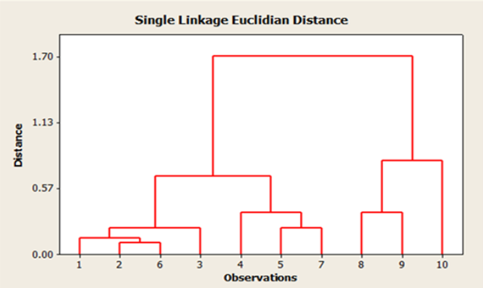
Hierarchical Clustering

Slide 11
Problems with Hierarchical Clustering
With increasing data; process becomes too slow and resource intensive
Tree diagrams become too cluttered to make any sense out of them
K-means clustering comes to the rescue

Slide 12
K means Clustering
You already tell the algorithm, how many clusters there are going to be in the data, that is the number.
You start with K random observations from the data, as K clusters.
Next observation is added to one of these clusters with the criterion which you have chosen.

Slide 13
K means Clustering Contd.
Centroid for the said data is calculated, this would be the new point from which distance from the cluster will be calculated.
This procedure is repeated until all the data points are assigned to clusters.

Slide 14
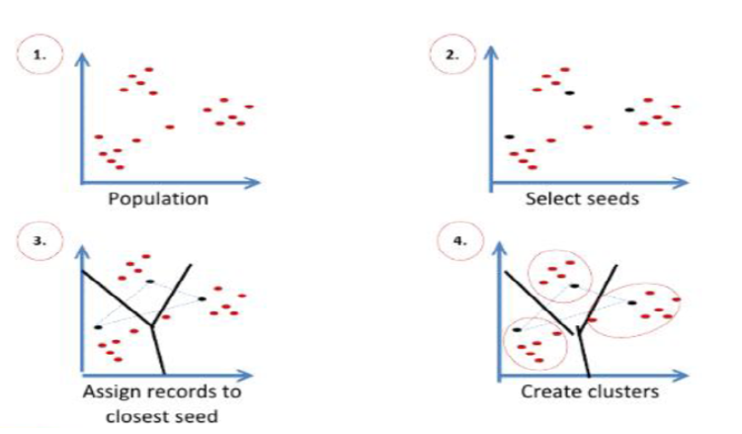
How does K-Means Clustering work?

Slide 15
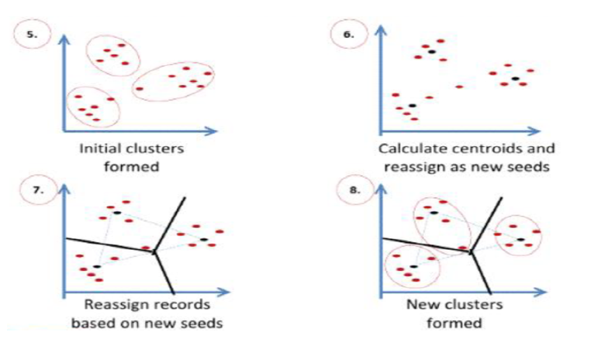
How does K-Means Clustering work?

Slide 16
Yippee Nothing will go wrong now…
But, actually something goes for a toss with K-means too. Guess what?
Sensitive to the selection of INAILIT EESDS

Slide 17
Did you guess the answer??
INITIAL SEEDS

Slide 18
That means we need to decide K??
What value of K is appropriate?
R² or WSS will keep on increasing/decreasing respectively with increase in value of K, until K equals the number of data points.
Where do we stop increasing K?

Slide 19
Sum of Squares and their partners in crime
For any given data Total sum of squares or SST is constant
SST= SSW + SSB, that is if we break our data into multiple groups. If these groups are formed, SSB is much higher w.r.t. to SSW.
As we increase number of groups SSW goes down.
With increase in K if fall in SSW is not rapid/ steep, it implies the higher number of groups are not resulting in better formed groups.

Slide 20
Effect on R²
R² = SSB/SST , as opposed to SSW, SSB goes up and equals SST if we have number of groups equal to data points. With increasing K, R² approaches to one.

Slide 21
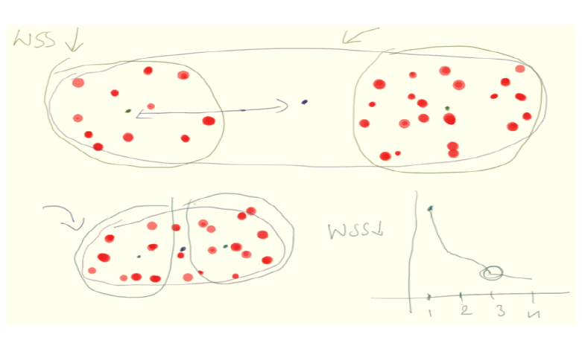
Effect on WSS – Deciding on no. of clusters

Slide 22
Other Method of deciding K
Does BSS help in deciding the value of K?
Now is that ratio called something? Ever heard of Calenski Criterion???

Slide 23
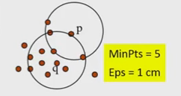
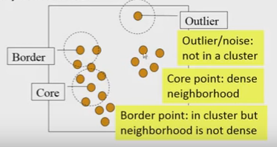
DBScan Clustering
Density based notion of cluster
Two parameters:
Eps: Maximum radius of the neighbourhood
Min Pts: Minimum number of points in the Eps-neighbourhood at a point
Eps-neighbourhood of a point q:
N_{eps}(q): {p belongs to D | dist(p,q) <= Eps}

Slide 24
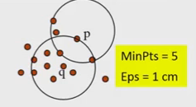
Directly Density Reachable and Density Connected
Directly Density Reachable
A point p is directly reachable to point q w.r.t. Eps, MinPts if
p belongs to N_{Eps}(q)
Core point condition: |N_{Eps(}(q)| > MinPts

Slide 25
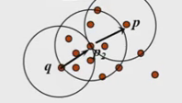
Directly Density Reachable and Density Connected
Density Reachable
A point p is density reachable to point q w.r.t. Eps, MinPts if there is a chain of points p₁, p₂, …, p_{n}, p₁ = q, p_{n} = p such that p_{i+1} is directly density reachable from p_{i}

Slide 26
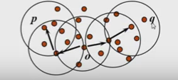
Directly Density Reachable and Density Connected
Density Connected
A point p is density connected to a point q w.r.t. Eps, MinPts if there is a point o such that both p and q are density reachable from o w.r.t. Eps and MinPts.

Slide 27
DB Scan Algorithm
Arbitrarily select any point p
Retrieve all points density-reachable from p w.r.t. Eps and MinPts
If p is a core point, a cluster is formed
If p is a border point, no points are density-reachable from p, and DBSCAN visits the next point of the database
Continue the process until all points have been processed
DB Scan is sensitive to setting of parameters Eps and MinPts

Slide 28
Rock Clustering: Categorical Attributes Handling
Reduction of Records to Transactions
In Records, each attribute slot can have multiple values
For every attribute A and value u, an item A.u is introduced
A Transaction includes A.u if and only if the attribute value of A is u
If the value of an attribute is missing in the record, then the corresponding transaction does not contain items for the attribute
So, missing values are ruled out “magically”!
That is, we measure the similarity of two records based only on the common items

Slide 29
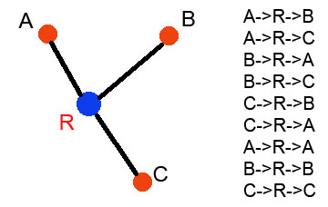
Links
A Link is defined as the number of common neighbours between two records
Intuitively, it is the number of distinct paths of length 2 that exist between a pair of points
Note that a point is considered as a neighbour of itself as well
There is a link from each neighbour of the “root” point back to itself through the root
Therefore, if a point has x neighbours, then x^2 links are due to it

Slide 30
Where are these used?
Marketing & Media
Banking & Insurance
Medical & Pharmaceuticals

